Slide 1
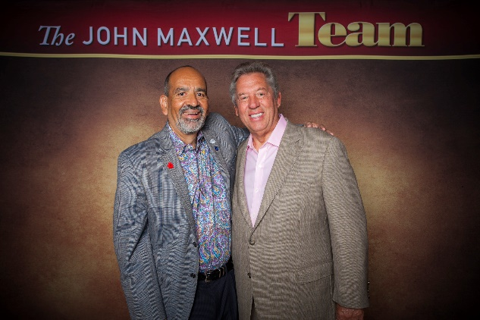
Welcome
Bienvenidos
Memo Vargas

Slide 2
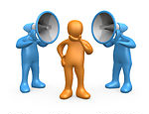
Leadership is…
INFLUENCE
Notes:
The true meaning of leadership is influence – nothing more, nothing less.
Law of EF Hutton – when the real leader speaks, people listen

Slide 3
Goal is to INCREASE influence
INFLUENCE
LEADERSHIP
Notes:
Increasing your influence equals increasing your leadership

Slide 4
Goal of training
Better understanding of influence
Increase influence with others

Slide 5
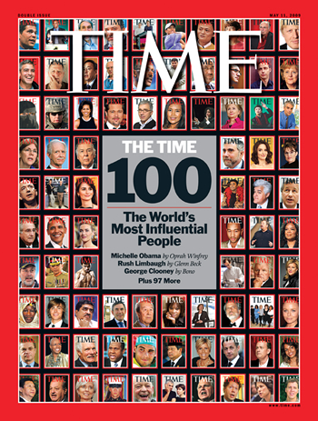
Influence Inventory
WHO do you influence?
Notes:
Principle – as a leader “attract who you are, not who you want”
List top 3 characteristics of who you want on your team… Do you possess those characteristics?

Slide 6
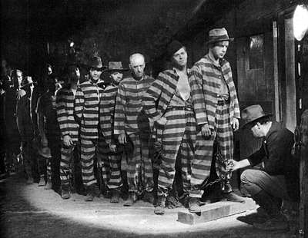
Influence Inventory
How do you influence others?
FORCE
Notes:
Principle – how you influence people will determine how many, how long, and how effectively you influence them.
Force – no choice in the decision

Slide 7
Influence Inventory
How do you influence others?
INTIMIDATION
Notes:
Intimidation – my way or the highway

Slide 8
Influence Inventory
How do you influence others?
MANIPULATION
Notes:
Manipulation – there’s a winner and a loser

Slide 9
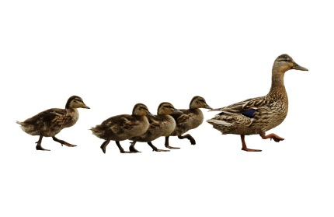
Influence Inventory
How do you influence others?
POSITION
Notes:
Positional – we follow because we have to

Slide 10
Influence Inventory
How do you influence others?
EXCHANGE
Notes:
Exchange – we both win something

Slide 11
Influence Inventory
How do you influence others?
PERSUASION
Notes:
Persuasion – we follow because we want to

Slide 12
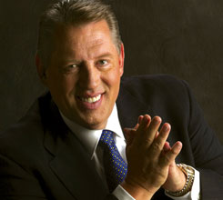
Influence Inventory
How do you influence others?
RESPECT
Notes:
Respect – we follow because of the request and respect for the influencer

Slide 13
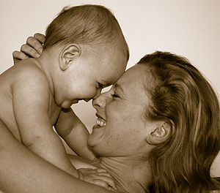
Influence Inventory
How MANY do you influence?
Notes:
Everyone influences someone, few people influence a lot of people

Slide 14
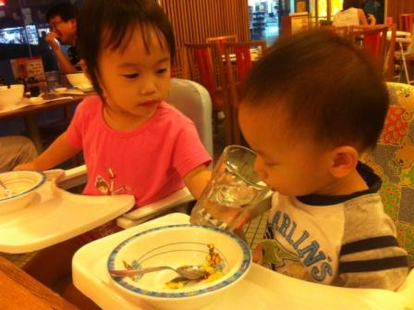
Influence Inventory
WHEN do you influence others?
Leaders sense:
Teachable Moments
LEADERS ARE READERS

Slide 15
Influence Inventory
WHEN do you influence others?
Leaders sense:
Breakthrough Places
Notes:
Hurt enough to have to change
Learn enough to want to change
Receive enough to be able to change

Slide 16
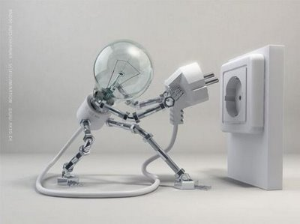
Influence Inventory
WHEN do you influence others?
Leaders sense:
Catalyst times

Slide 17
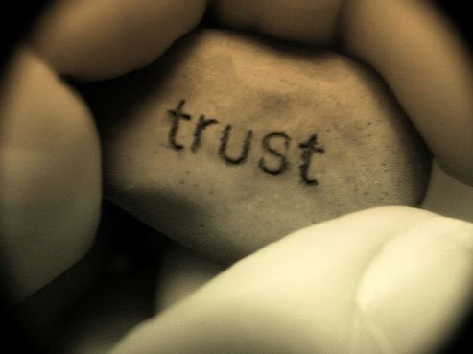
Influence Inventory
WHY do you influence others?
Notes:
Principle – why you do something will ultimately determine what you do
Right motives are crucial to people because leadership functions on the basis of trust
Continual wrong motives are a result of bad character

Slide 18
Influence Inventory
WHERE do you influence others?
Notes:
Mistake – if I’m not on top, I can’t lead. Leadership is influence not position
When I get to the top, then I will learn to lead
If I were on top, everyone would follow – if people don’t follow you now, they won’t follow you then
When I get to the top I will be able to do anything – when you get to the top you have to practice servant leadership

Slide 19
Insights into influence
Leadership is INFLUENCE
Our influence with others is usually not in ALL AREAS
With influence comes RESPONSIBILITY
My influence with others is either POSITIVE or NEGATIVE
Our influence can GROW
People of positive influence ADD VALUE to others

Slide 20
10 WAYS TO INCREASE INFLUENCE
Notes:
Trust is the glue that holds people together.
Does my organization have good written values?
Do the leaders practice and model them for others?
Do I place the interests of my people above my own?
Am I accountable to others for my actions?
Since I know myself best, do I like who I am?

Slide 21
10 WAYS TO INCREASE INFLUENCE
NURTURE
Notes:
Nurturing people:
Does not mean needing people
Does mean commitment to people
Does mean loving people
Does mean lifting people to a higher level

Slide 22
10 WAYS TO INCREASE INFLUENCE
Notes:
Assets make things possible
People make things happen
Fear – if we are afraid of people we cannot confront them
Dislike – if we dislike people we should not lead them
Contempt – if we look down on people, we will not value them
Borrowed beliefs have no power
We become outside what we believe inside
Lack of belief in people hurts both the leader and the people
The greatest gift a leader gives another person is to express belief in that person when that person doesn’t believe in himself

Slide 23
10 WAYS TO INCREASE INFLUENCE
Look at speaker
Ask questions
Don’t interrupt
Don’t change subject
Emotion
Responsive listening
LISTEN
Notes:
Look at speaker – meanings are not in words, but in people
Ask questions – this is the quickest way to become a listener
Don’t interrupt – it is just as rude to step on people’s ideas as it is to step on their toes.
Don’t change subject – listening is wanting to hear
Emotion – leaders must keep current of the undercurrents
Responsive listening – when people feel that their leads no longer listens or responds, they will go somewhere else
To become a better listener:
What is their heart?
What is their hope?
What is their hurt?
How can I help?

Slide 24
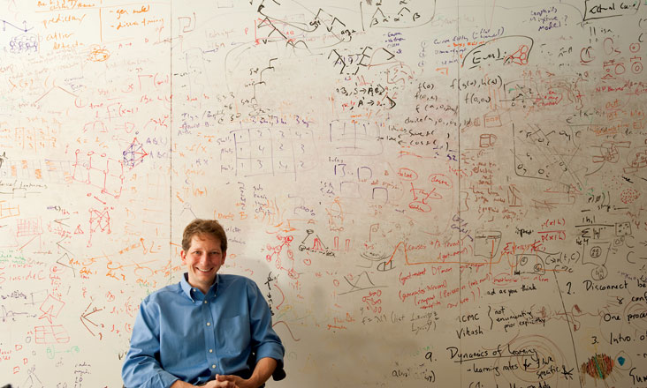
10 WAYS TO INCREASE INFLUENCE
UNDERSTAND
Notes:
Why relationships fail:
Fear which causes us to erect barriers
Selfishness which causes us to focus on self instead of others
Keys…

Slide 25
10 WAYS TO INCREASE INFLUENCE
GROW YOURSELF
GROW PEOPLE
GROW ORGANIZATION
ENLARGES
Notes:
You cannot give what you do not have
Success is knowing your purpose in life, growing to your maximum potential, and sowing seeds that benefit others
Success – when you work hard to better yourself
Significance – when you work hard to better others

Slide 26
10 WAYS TO INCREASE INFLUENCE
NAVIGATES
Notes:
There are those who can see the problem ahead and avoid it.
There are those who can experience the problem and fix it.
There are those who can not see the problem or fix it and they are overwhelmed.
A leader is one who sees more than others see, farther than others see, before others see
Experience – been there did that
Success – been there did that successfully
Responsibility – I’m willing to take others on the trip
Communication – Encouraging –honest –continual
Partnership – we go together – we help each other

Slide 27
10 WAYS TO INCREASE INFLUENCE
CONNECTS
Notes:
Credibility + Communication = Connections
Relationships – people listen because of who you know
Sacrifice - people listen because of what you have suffered
Insight - people listen because of what you know
Experience - people listen because of what you have achieved
Abilities - people listen because of what you are able to do
Intuition - people listen because of what you sense
Character - people listen because of your integrity
Humility - people listen because of your heart
Relevance - people listen because you identify with their needs
Convictions - people listen because of your passion
Go to their world. Communicate from the heart. Find the key to their life.

Slide 28
10 WAYS TO INCREASE INFLUENCE
EMPOWERS
Notes:
Determine not to know everything, not to know everything first, not to become the primary source of communication, to let someone else represent you, to stay with your strengths.
Empowerment means:
Seeing the potential of the individual and the proper fit for the job
Saying words that encourage, equip and empower that person
Sharing your knowledge, experience and influence with them
Showing to others your belief in and power given to that person

Slide 29
10 WAYS TO INCREASE INFLUENCE
80% of leaders attract followers
REPRODUCES

Slide 30
10 WAYS TO INCREASE INFLUENCE
10% of leaders attract leaders
REPRODUCES

Slide 31
10 WAYS TO INCREASE INFLUENCE
5% of leaders reproduce leaders
REPRODUCES
Notes:
Model good leadership
Provide leadership training
Provide leadership resources
Provide leadership experiences
Create a growth environment

Slide 32
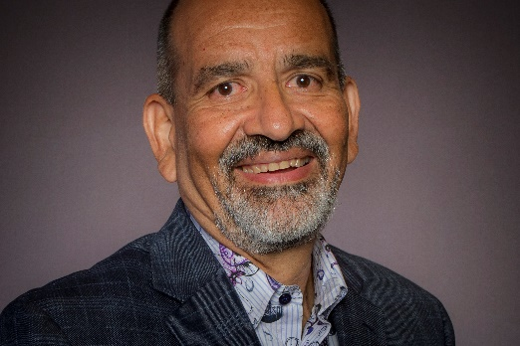
Thank You
Gracias
Memo Vargas

